Slide 1


Guiding children and young people through life’s storms.

Slide 2

When a change takes place in the family, whether it is death, divorce, separation or abandonment, it has a profound effect on all members of the family.

Slide 3
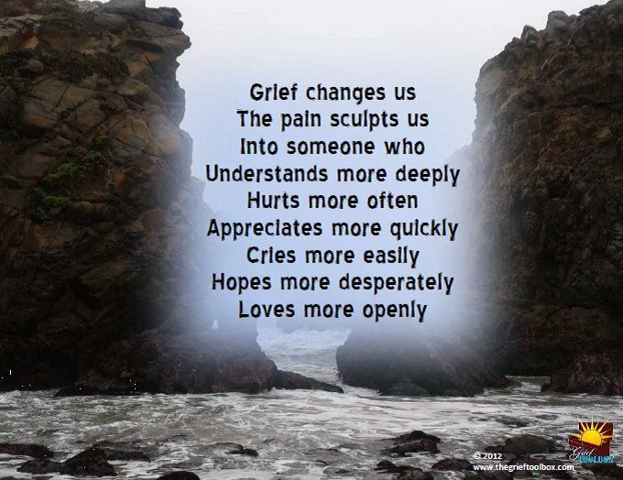

Slide 4

Grieving is a natural process that comes from the emotional loss. If grief is not dealt with at the appropriate time, it may be repressed or even become chronic.

Slide 5

When grief does not have the opportunity to be resolved, it can become debilitating and even destructive. It is an expression of love. It is a normal human reaction to a significant loss.

Slide 6

Rainbows provides a safe setting in school in which children and young people can talk through their feelings with their peers who are experiencing similar situations.

Slide 7


Slide 8
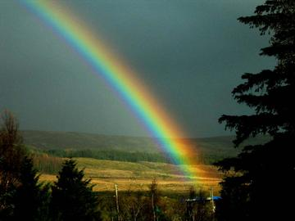
Rainbows acknowledges that grief needs to be recognised and supported; not denied, buried or ignored.

Slide 9


Slide 10

Rainbows fosters emotional wellbeing among children, young people and adults who are grieving a loss through a death, divorce, separation or any other painful transition in their lives.

Slide 11

Rainbows supports self – esteem, trust, confidence and resilience.

Slide 12

“The programme made a huge difference to our family life. We found that our son
was more able to cope with his grief and loss.”

Slide 13

Rainbows promotes emotional development and positive, healthy relationships.

Slide 14
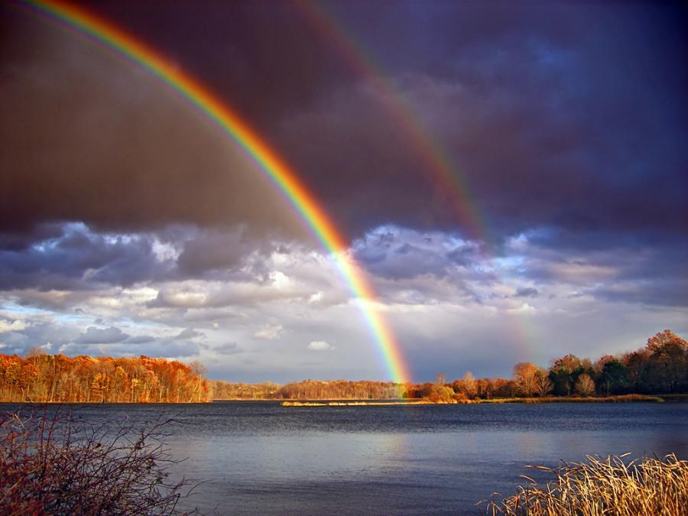

Slide 15
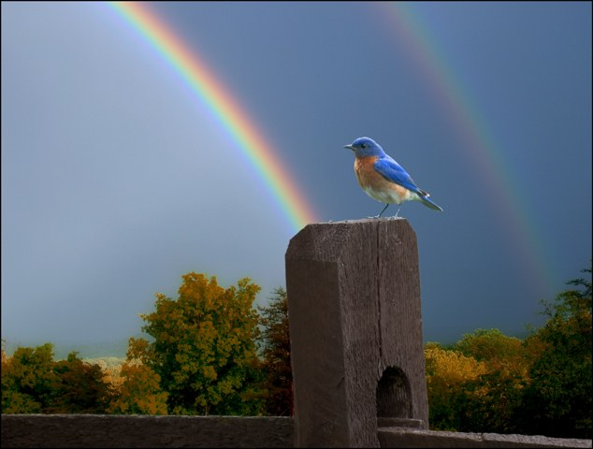
“I just would like to say
a big thank you to you all with helping my child talk about what is on his mind.”

Slide 16

“Rainbows has made my child grow in confidence. He has come out of his shell rather than getting angry, he now sits and talks his feelings through.”

Slide 17


Slide 18


Slide 19

“The support my child received was second to none. We could not have survived without Rainbows. Long may it continue.”

Slide 20


Slide 21
Guiding children and young people through life’s storms.

